Slide 1

Rent or Buy Dashboard Demo
Apartment in NYC vs Home in Long Island
Barbara Talagan, Lauren Darienzo, Nisha Ramasubramonian, Tiffany Pham, Uzair Siddiq
Notes:
Lauren
Hello, today Barb, Nisha, Tiffany, Uzair and I will be demonstrating a renting and buying dashboard for deciding where to live in New York.
_______________
Please upload your recordings here by 12am est / 9pm pst: https://drive.google.com/drive/folders/1_bCjT53LIlHapN_peD95LeB3BIyekVW_?usp=sharing

Slide 2

Introduction
There are many factors to consider when choosing whether to rent or buy a home, but what gives most prospective homeowners the greatest anxiety is the unknown financial impact of their decision.
Buyers must ask themselves — is now the right time to buy, where should I rent or buy, and how much is my decision to rent or buy going to cost me now and in the future?
The economic uncertainties can be overwhelming.
Notes:
LAUREN
There are many factors to consider when choosing whether to rent or buy a home, but what gives most prospective homeowners the greatest anxiety is the unknown financial impact of their decision.
Buyers must ask themselves — is now the right time to buy, where should I rent or buy, and how much is my decision to rent or buy going to cost me now and in the future?
The economic uncertainties can be overwhelming.
[go to next slide]

Slide 3
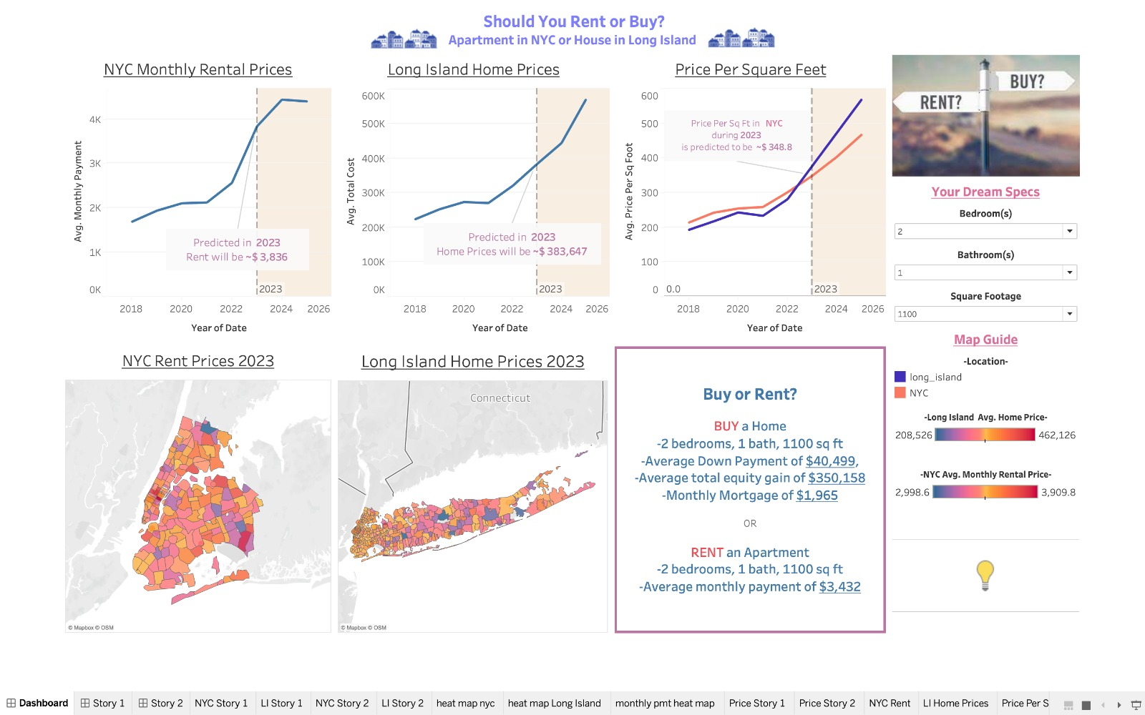
Dashboard Demo
Notes:
Lauren: [Transition] Now, we are going to switch over to Barbara to give you a tour of our dashboard
3-4 minutes
Thank you Lauren, so we are going to start at the right panel right here where the user can
Barb: [explain how to use the dashboard]
Filters
What the line charts show and the forecast
What the heat maps show and the forecast
Comparison of the trend lines
Trade off box
lightbulb
Thank you Lauren, so we are going to start at the right panel right here. To start using the dashboard we have some instructions on this lightbulb where it directs the user to use the following drop down’s to input their bath, bedroom, and sq footage preferences.
Which will automatically update the dashboard and provide analytics on both rental prices in New York City, home prices in Long Island, and even a breakdown of prices per square footage
So we used a time series data to get information on pricing trends and we have provided not only a historical breakdown of these prices but also a forecast which to the right of this dotted line here.
Down on the bottom row we have maps showing prices by zip code for both rent in New York City and housing prices in Long Island. And you can even zoom in and compare the prices of specific zip codes together by looking at the colors so as the prices get higher the color becomes more warm and vice versa.
Finally we have our recommendation box which gives the user a breakdown of the specific costs related to renting or buying such as down payment, equity gain, mortgages, and monthly rent. After being presented with the tradeoffs of renting or buying, the user can arrive at a well-informed conclusion on whether to rent in New York City or Buy in Long Island.
so we are going to start at the top row here which is giving the user, r
To the left of these dotted lines are historical prices while on the right we have predictive prices so that the user can understand housings trends in both the past and future.
Now moving to the bottom row, we have maps showing predicted 2023 prices for both rent in New York City and housing in long island. You can even zoom in to see compare prices between zip codes.
Finally we have our recommendation to the user giving them the tradeoff of costs between renting in New York City or buying a home in Long Island.

Slide 4

Story 1: John
John had just graduated from Cornell University and landed his dream job in the bustling city of New York. As a recent graduate, he was faced with the daunting task of finding the perfect place to live. Should he rent an apartment in the heart of NYC or invest in a home in Long Island?
Notes:
UZAIR
John had just graduated from Cornell University and landed his dream job in the bustling city of New York. As a recent graduate, he was faced with the daunting task of finding the perfect place to live. Should he rent an apartment in the heart of NYC or invest in a home in Long Island?
[TRANSITION TO DASHBOARD]
Seeking guidance, John stumbled upon a dashboard designed to assist individuals like him in making this crucial decision.
[PUT IN THE FILTERS FOR DASHBOARD]
He inputted his preferences: 2 bedrooms, 1 bathroom, and a spacious 1100 square feet.
Taking into account the historical averages and predictive data, John carefully analyzed his options. After thoughtful consideration, he decided to rent an apartment in NYC.
The dashboard generated three insightful graphs for him to consider.
The first graph showcased the forecast of monthly rent over the years. John noticed a dynamic text box that highlighted, "Average Rent in 2023 is $X." This information provided him with a glimpse into the expected rental prices in NYC, giving him an idea of his potential monthly expenses.
The second graph presented the forecast of house prices over time, accompanied by another dynamic text box that displayed, "Mortgage Payment $X with a Downpayment of $Y." This data enabled John to visualize the financial commitment required to own a home in Long Island, making him aware of the potential investment he would be making.
The third graph, a comparison of the pricing.
Below are the Rent/House Price by Zipcode Heat Map, allowing John to compare rental costs and house prices across different areas, giving him valuable insights into the market trends in both NYC and Long Island.
The information provided by the dashboard helped him understand the current rental market and allowed him to make an informed choice that aligned with his preferences and financial goals.
[TRANSITION BACK TO SLIDES]

Slide 5

Story 2: Emma and Michael
Emma and Michael, a well-to-do couple, found themselves in need of a larger home for their growing family in New York. They had the luxury of choice and were open to either living in the heart of the city or settling in the suburbs. They desired a larger space to accommodate their needs, looking for a 3 bedrooms and 2 bathrooms. Which option would be best for them?
Notes:
TIFF
Emma and Michael, a well-to-do couple, found themselves in need of a larger home for their growing family in New York. They had the luxury of choice and were open to either living in the heart of the city or settling in the suburbs. They desired a larger space to accommodate their needs, looking for a 3 bedrooms and 2 bathrooms. Which option would be best for them?
[Transition back to demo]
Eager to make a wise investment, Emma and Michael stumbled upon a dashboard designed to help them navigate their decision-making process. They entered their desired specifications, and the dashboard generated a comprehensive set of graphs to assist them.
The FIRST graph illustrated the forecast of monthly rent in NYC, giving them insights into the expected rental prices over time. This data allowed them to gauge the potential monthly expenses they might incur if they decided to rent a property in the city.
The SECOND graph depicted the historical averages for Long Island, showcasing the forecast of house prices over the years. The dynamic text box provided them with valuable information, displaying the mortgage payment amount for their desired property, along with the required down payment.
Observing all the averages and considering their long-term plans, Emma and Michael ultimately chose to invest in a house in Long Island. The dashboard's visualizations enabled them to make an informed decision that aligned with their desire for a spacious home and their understanding of the market trends. Armed with the knowledge provided by the dashboard, the couple felt confident that their investment in Long Island IS a profitable return in the future.
[transition back to deck]

Slide 6

Conclusion
This interactive dashboard proved to be valuable tools for John, Emma, and Michael.
By providing insights into rental prices, house prices, and market trends, the dashboards empowered them to make well-informed decisions that considered their preferences, financial goals, and long-term plans.
Notes:
NISHA
This interactive dashboard proved to be valuable tools for John, Emma, and Michael.
By providing insights into rental prices, house prices, and market trends, the dashboards empowered them to make well-informed decisions that considered their preferences, financial goals, and long-term plans.
_______________
Please upload your recordings here by 12am est / 9pm pst: https://drive.google.com/drive/folders/1_bCjT53LIlHapN_peD95LeB3BIyekVW_?usp=sharing

Slide 7





Thank You
Questions? Feel free to contact us!
Lauren
Darienzo ljd5@cornell.edu
Tiffany
Pham
tlp65@cornell.edu
Nisha
Ramasubramonian
nr352@cornell.edu
Uzair
Siddiq
uas5@cornell.edu
Barbara
Talagan
bat63@cornell.edu
Notes:
NISHA
Thank you for attending this demonstration on renting and buying in New York. If you have any questions, feel free to contact any of the team members and we will be happy to address any questions.
[END]
_____________
Please upload your recordings here by 12am est / 9pm pst:
https://drive.google.com/drive/folders/1_bCjT53LIlHapN_peD95LeB3BIyekVW_?usp=sharing

